Slide 1
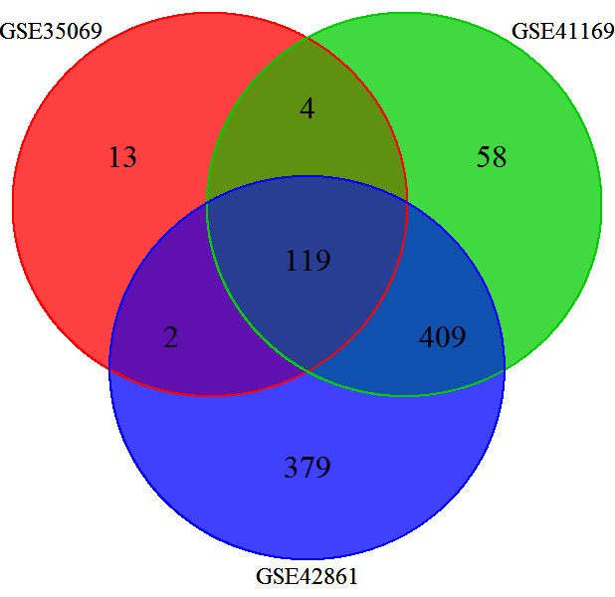
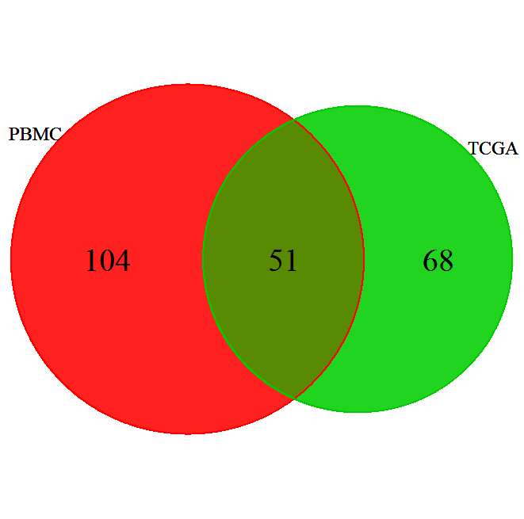
34 33 51
TCGA
CpG Island
34 18 53
Non-CpG Island
P<1.92× 10⁻⁹
P<1.0 × 10⁻⁴

